Slide 1
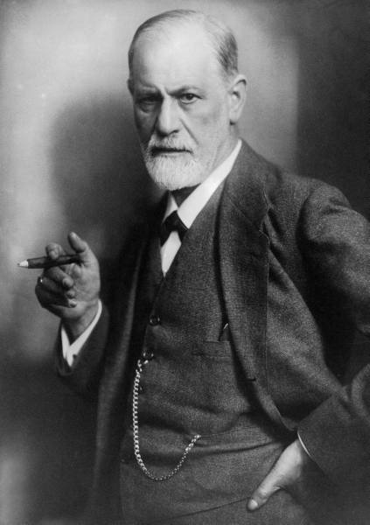
Can you name this person?
Notes:
Sigmund Freud!

Slide 2
Can you name this person?
Notes:
Sigmund Freud!

Slide 3
Can you name this person?
Notes:
Sigmund Freud!

Slide 4
Can you name this person?
Notes:
Sigmund Freud!

Slide 5
Can you name this person?
Notes:
Sigmund Freud!

Slide 6
Can you name this person?
Notes:
Sigmund Freud!

Slide 7
Can you name this person?
Notes:
Sigmund Freud!

Slide 8
Can you name this person?
Notes:
Sigmund Freud!

Slide 9
Can you name this person?
Notes:
Sigmund Freud!

Slide 10
Can you name this person?
Notes:
Sigmund Freud!

Slide 11
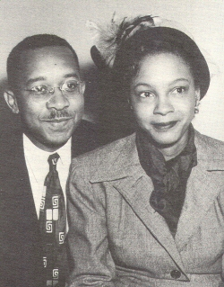
Can you name these people?
Notes:
Kenneth & Mamie Phipps Clarke, ala Doll Study

Slide 12
Can you name these people?
Notes:
Kenneth & Mamie Phipps Clarke, ala Doll Study

Slide 13
Can you name these people?
Notes:
Kenneth & Mamie Phipps Clarke, ala Doll Study

Slide 14
Can you name these people?
Notes:
Kenneth & Mamie Phipps Clarke, ala Doll Study

Slide 15
Can you name these people?
Notes:
Kenneth & Mamie Phipps Clarke, ala Doll Study

Slide 16
Can you name these people?
Notes:
Kenneth & Mamie Phipps Clarke, ala Doll Study

Slide 17
Can you name these people?
Notes:
Kenneth & Mamie Phipps Clarke, ala Doll Study

Slide 18
Can you name these people?
Notes:
Kenneth & Mamie Phipps Clarke, ala Doll Study

Slide 19
Can you name these people?
Notes:
Kenneth & Mamie Phipps Clarke, ala Doll Study

Slide 20
Can you name these people?
Notes:
Kenneth & Mamie Phipps Clarke, ala Doll Study

Slide 21
Can you name this symbol?
Notes:
Psychology!

Slide 22
Can you name this symbol?

Slide 23
Can you name this symbol?

Slide 24
Can you name this symbol?

Slide 25
Can you name this symbol?

Slide 26
Can you name this symbol?

Slide 27
Can you name this symbol?

Slide 28
Can you name this symbol?

Slide 29
Can you name this symbol?

Slide 30
Can you name this symbol?

Slide 31
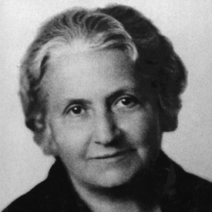
Can you name this person?
Notes:
Maria Montessori
http://www3.niu.edu/acad/psych/Millis/History/2003/womeninpsych_3.htm

Slide 32
Can you name this person?
Notes:
Maria Montessori
http://www3.niu.edu/acad/psych/Millis/History/2003/womeninpsych_3.htm

Slide 33
Can you name this person?
Notes:
Maria Montessori
http://www3.niu.edu/acad/psych/Millis/History/2003/womeninpsych_3.htm

Slide 34
Can you name this person?
Notes:
Maria Montessori
http://www3.niu.edu/acad/psych/Millis/History/2003/womeninpsych_3.htm

Slide 35
Can you name this person?
Notes:
Maria Montessori
http://www3.niu.edu/acad/psych/Millis/History/2003/womeninpsych_3.htm

Slide 36
Can you name this person?
Notes:
Maria Montessori
http://www3.niu.edu/acad/psych/Millis/History/2003/womeninpsych_3.htm

Slide 37
Can you name this person?
Notes:
Maria Montessori
http://www3.niu.edu/acad/psych/Millis/History/2003/womeninpsych_3.htm

Slide 38
Can you name this person?
Notes:
Maria Montessori
http://www3.niu.edu/acad/psych/Millis/History/2003/womeninpsych_3.htm

Slide 39
Can you name this person?
Notes:
Maria Montessori
http://www3.niu.edu/acad/psych/Millis/History/2003/womeninpsych_3.htm

Slide 40
Can you name this person?
Notes:
Maria Montessori
http://www3.niu.edu/acad/psych/Millis/History/2003/womeninpsych_3.htm

