Slide 1
Making Your Research Reproducible

Slide 2
Reproducibility with Available Data
Authors | Attempt to Reproduce Findings | % of Reproduced Findings
Naudet et al., 2018 | RCTs in leading biomedical journals | 82
Artner et al., 2020 | Psychology articles published in 2012 | 70
Wolins, 1962 |  | 57
Maasen et al., 2020 | Individual effect sizes in meta-analyses in psychology | 55
Eubank, 2016 | Articles published in Quarterly Journal of Political Science | 42

Slide 3
Reproducibility without Available Data
Authors | Attempt to Reproduce Findings | % of Reproduced Findings
Laurinavichyute et al. 2022 | Articles published in the Journal of Memory and Language | 34-51
Chang & Li, 2015 | Papers published in economics journals | 33/43
Hardwicke et al., 2018 | Articles published in the journal Cognition | 11/22
Stodden et al., 2018 | Articles published in the Journal of Computational Physics | 26
Notes:
Laurinavichyute et al. 2022 34%-51% (depending on strictness of criterion)
Chang & Li 2015 33% (without assistance from original authors)
43% (including those with assistance from original authors)
Hardwicke et al., 2018 11% (without assistance from original authors)
22% (including those with assistance from original authors)

Slide 4
What is “Open” Science?
Scientific research that has a set of foundational values and principles:
Openness
Transparency
Integrity
The goals of “Open Science”
Reduce researcher biases
Increase reliability of research
Encourage collaboration
Set a new standard in science

Slide 5
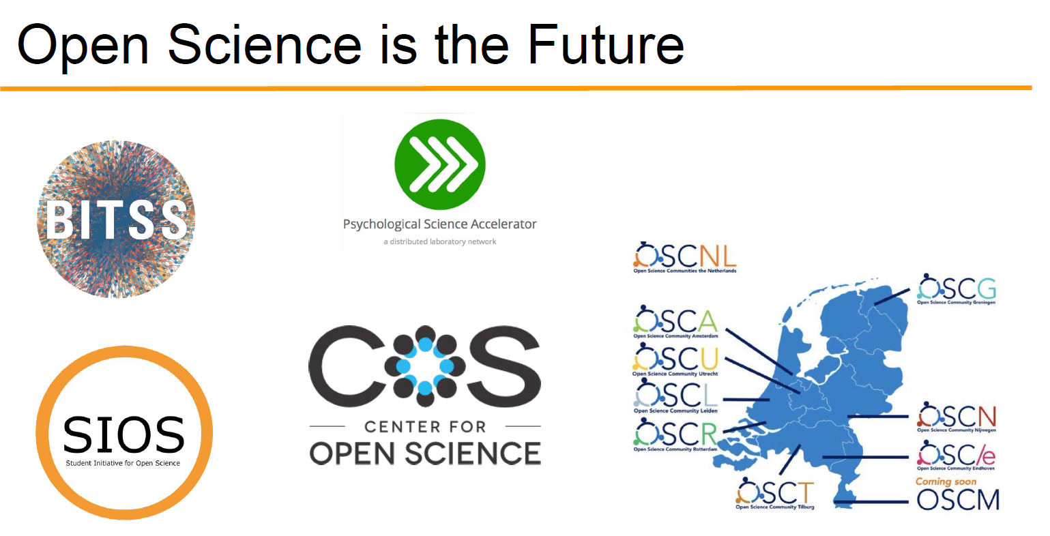
What does that look like in practice?
Pre-prints
Pre-registration
Open
  Data
  Access
  Software
  Code & Materials
Notes:
BITSS: Berkeley Initiative for Transparency in the Social Sciences
Studenent Initiative for Open Science
Psych Accelerator

Slide 6
Terminology
Replicability
reproducibility
ROBUSTNESS
Same procedures
New data
Same analyses
Same results
Same procedures
Same data
Same code
Same results
Same procedures
New data
Same analyses
Same results

Slide 7
Standards of Reproduction
Sufficiency
Portability
Easy reproduction
Notes:
Sufficiency
The documentation for a project should contain all the data, scripts, and supplementary information necessary to enable any user (with access to and basic proficiency in the software used) to reproduce all the results presented in the report without undue difficulty.
The user should not have to seek assistance from the person who conducted the study.
Portability
Provided the necessary software is installed, any user should be able to copy the Project/ folder, with the hierarchy of subfolders and files it contains intact, onto their own computer or workspace, and then run the scripts that reproduce the project locally.
Easy reproduction
The one click that runs the Master Script (R) or opens the JASP file is then (almost) all the user needs to do to reproduce the project.

Slide 8

TIER Protocol
A flexible framework for application to a wide variety of contexts and projects.
Designed to help students ensure their work is transparent and reproducible.
Specifications & detailed, but easy-to-follow, process.
Ball, R., Medeiros, N. Project TIER Protocol. Retrieved from http://www.projecttier.org/
Notes:
The TIER Protocol specifies the contents and organization of reproduction documentation for a project involving computations with statistical data.
Documentation that meets the specifications of the TIER Protocol contains all the data, scripts, and supporting information necessary to enable you, your instructor, or an interested third party to reproduce all the computations necessary to generate the results you present in the report you write about your project.

Slide 9
Organizing Your Files for Reproducibility (JASP)

Slide 10
Organizing Your Files for Reproducibility (R)

Slide 11
Documenting Your Data
A data dictionary explains how to make sense of your data files.
It should include:
The source from which you obtained the data.
The date on which you downloaded the original data file.
A brief (1-2 sentence) summary of the research that produced the data.
The following information for each variable:
  name
  definition/description, including units and level of measurement
  an explanation of the coding scheme, if it is not obvious.
Notes:
The box at the right shows a sample data dictionary.

Slide 12
Example Data Dictionary
The folder OriginalDataFiles contains raw data from a study of sustained attention. Participants viewed a series of stimulus probes that flashed onscreen, one every 1.5 seconds. Some probes were defined as signals ad others as non-signals. The participants’ task was to press a response key when a signal occurred (go trials) and to withhold the key press on trials when a non-signal appeared (no-go trials).
Data were collected in the authors’ laboratories in Fall 2019.
Variables are:
ID: the participant’s id code (nominal)
Block: Each participant performed the task for 20 minutes, uninterrupted. That was divided into 5 blocks of 4 minutes each. (nominal)
Trial: Trial number, ordered sequentially. (nominal)
Signal: indicates whether the stimulus each trial was a signal event, requiring a response, or a noise event, requiring no response (nominal). Coding:
  “NoGo” = noise event
  “Go” = signal event.
Response: Indicates whether the participant responded or not (nominal)
ACC: accuracy, indicates whether the participant’s behavior each trial (respond or withhold response) was appropriate to the stimulus (nominal). Coding:
“0” = not appropriate (mismatch between stimulus and response)
“1” = appropriate (match between stimulus and response)
RT: Response times, in seconds. A value of -1 indicates that the participant withheld a response that trial. (ratio)

